Slide 1

LinC : Opportunity Awaits
Team: 8
Vishnu Vardhan Rongali - 22L31A5484
Kumar Ganesh Sabbavarapu - 22L31A5486
Bhanu Avinash Varma Uppalapathi - 22L31A54A2
Suresh Mekala - 22L31A5460
Rukesh Reddi - 23L35A5421
GUIDE NAME : Mr.Gouri Sankar Nayak

Slide 2
INDEX :
Abstract
Project Domain
Existed System
Proposed System
Technologies Used

Slide 3
ABSTRACT
LinC is a comprehensive platform designed to bridge the gap between students and job opportunities by offering an integrated suite of tools to enhance the job-seeking experience. The platform includes an Applicant Tracking System (ATS) that streamlines the recruitment process for employers and job seekers alike, a Resume Builder that helps users craft professional resumes tailored to industry standards, and a Job Tracking feature that allows users to monitor and manage their job applications. Additionally, LinC leverages advanced AI capabilities to offer a chat feature powered by Langchain, facilitating seamless communication and providing real-time guidance. The platform is built using Flask, HTML, JavaScript, and an SQLite3 database, ensuring a robust and user-friendly experience.

Slide 4
Project Domain
Career Management and Recruitment

Slide 5
EXISTING SYSTEM
The existing system offers basic job search and application features. However, it can be enhanced with personalized matching, interactive engagement, and streamlined processes. This motivates the development of a new platform with improved capabilities.
Limited Job Matching :The existing system offers basic job search functionality but lacks advanced algorithms for personalized job matching based on user skills and preferences.
Manual Application Process: Users must manually fill out job application forms or attach resumes, resulting in a cumbersome and time-consuming application process.
Passive Job Alerts : Job alert notifications are limited to basic email alerts and do not provide real-time updates or personalized recommendations based on user activity.
Static Filters: : Users can filter job listings based on generic criteria such as location or job type, but the system lacks interactive and dynamic filtering options for refining search results.

Slide 6
PROPOSED SYSTEM
The proposed system for the Linc project aims to enhance the user experience and functionality of our platform for connecting students with part-time job opportunities. By incorporating advanced technologies and features, we aim to:
Enhanced Applicant Tracking System (ATS) : Streamlines the recruitment process for both job seekers and employers, providing real-time updates and detailed insights into application statuses.
Customizable Resume Builder: IProvides industry-specific templates and professional resume guidance..
AI-Powered Chat : Offers real-time support and personalized guidance during the job search.
Real-time Notifications : Implement instant alerts for new job postings and application updates to keep students engaged.
Seamless Applications : Simplify the application process with one-click apply and resume parsing, enhancing user convenience and success rates.

Slide 7
TECHNOLOGIES USED
Frontend Development: HTML5 , CSS3 , JavaScript ,Bootstrap
Backend Development : Python (Flask framework)
Database Management: SQLite
Development Tools: VSCode, Git
Core LLM Models: Gemini , Gemma , Groq
Supporting Tools: Langchain , FAISS

Slide 8
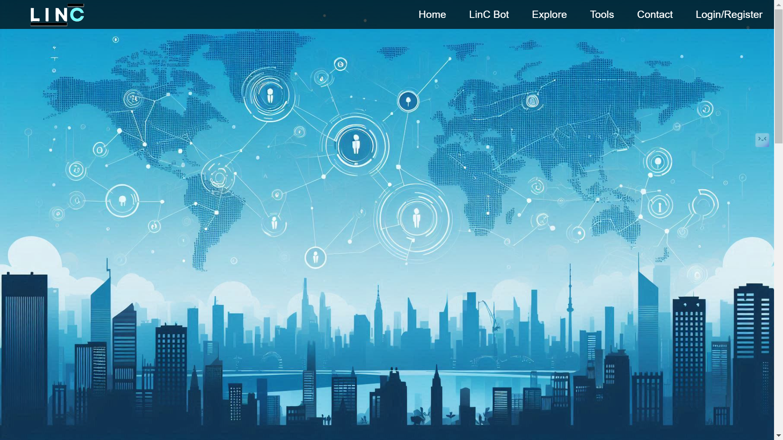

Slide 9
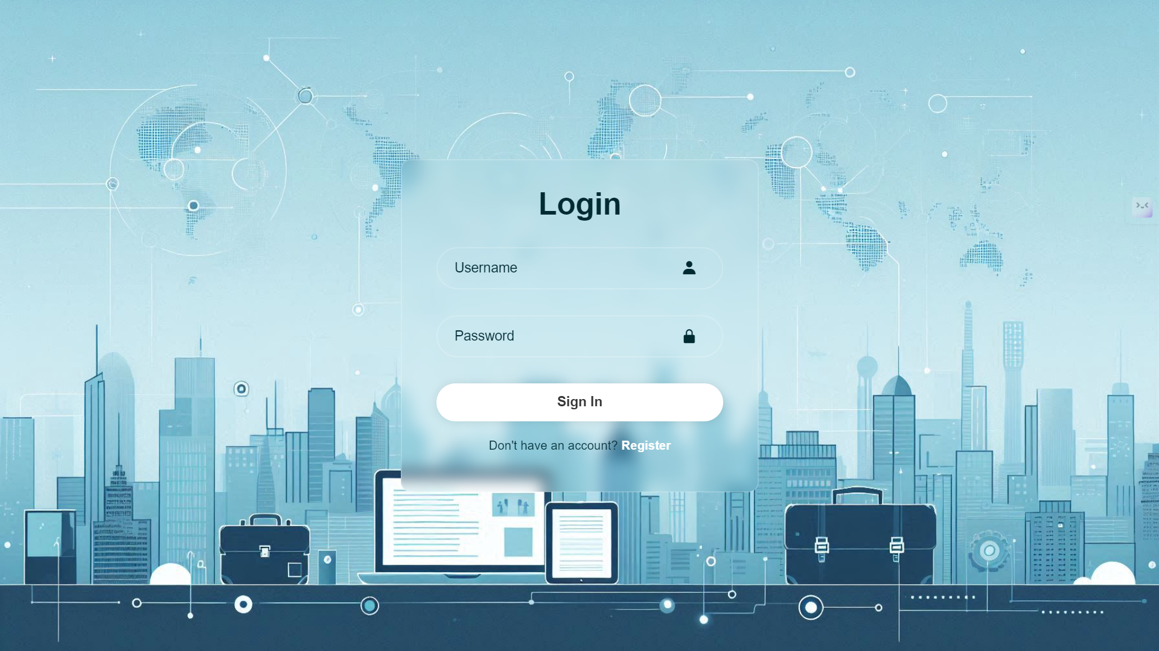

Slide 10
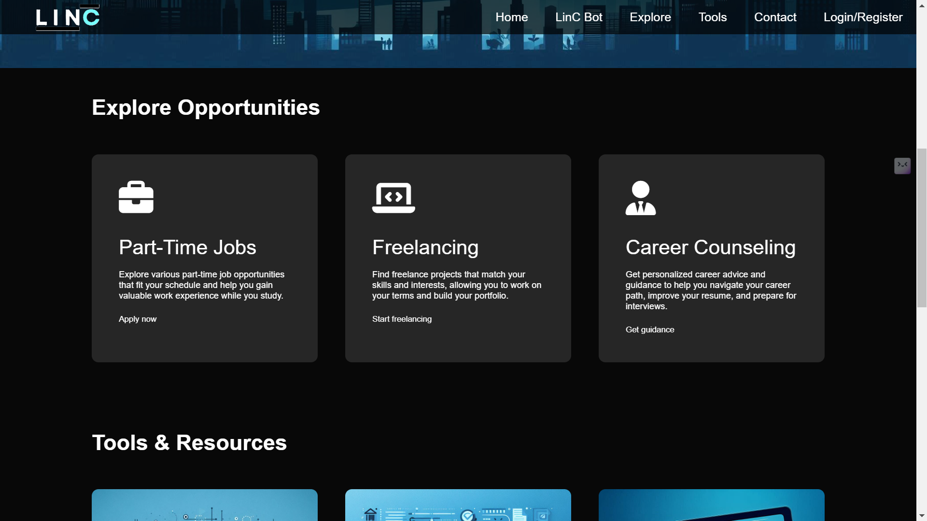

Slide 11
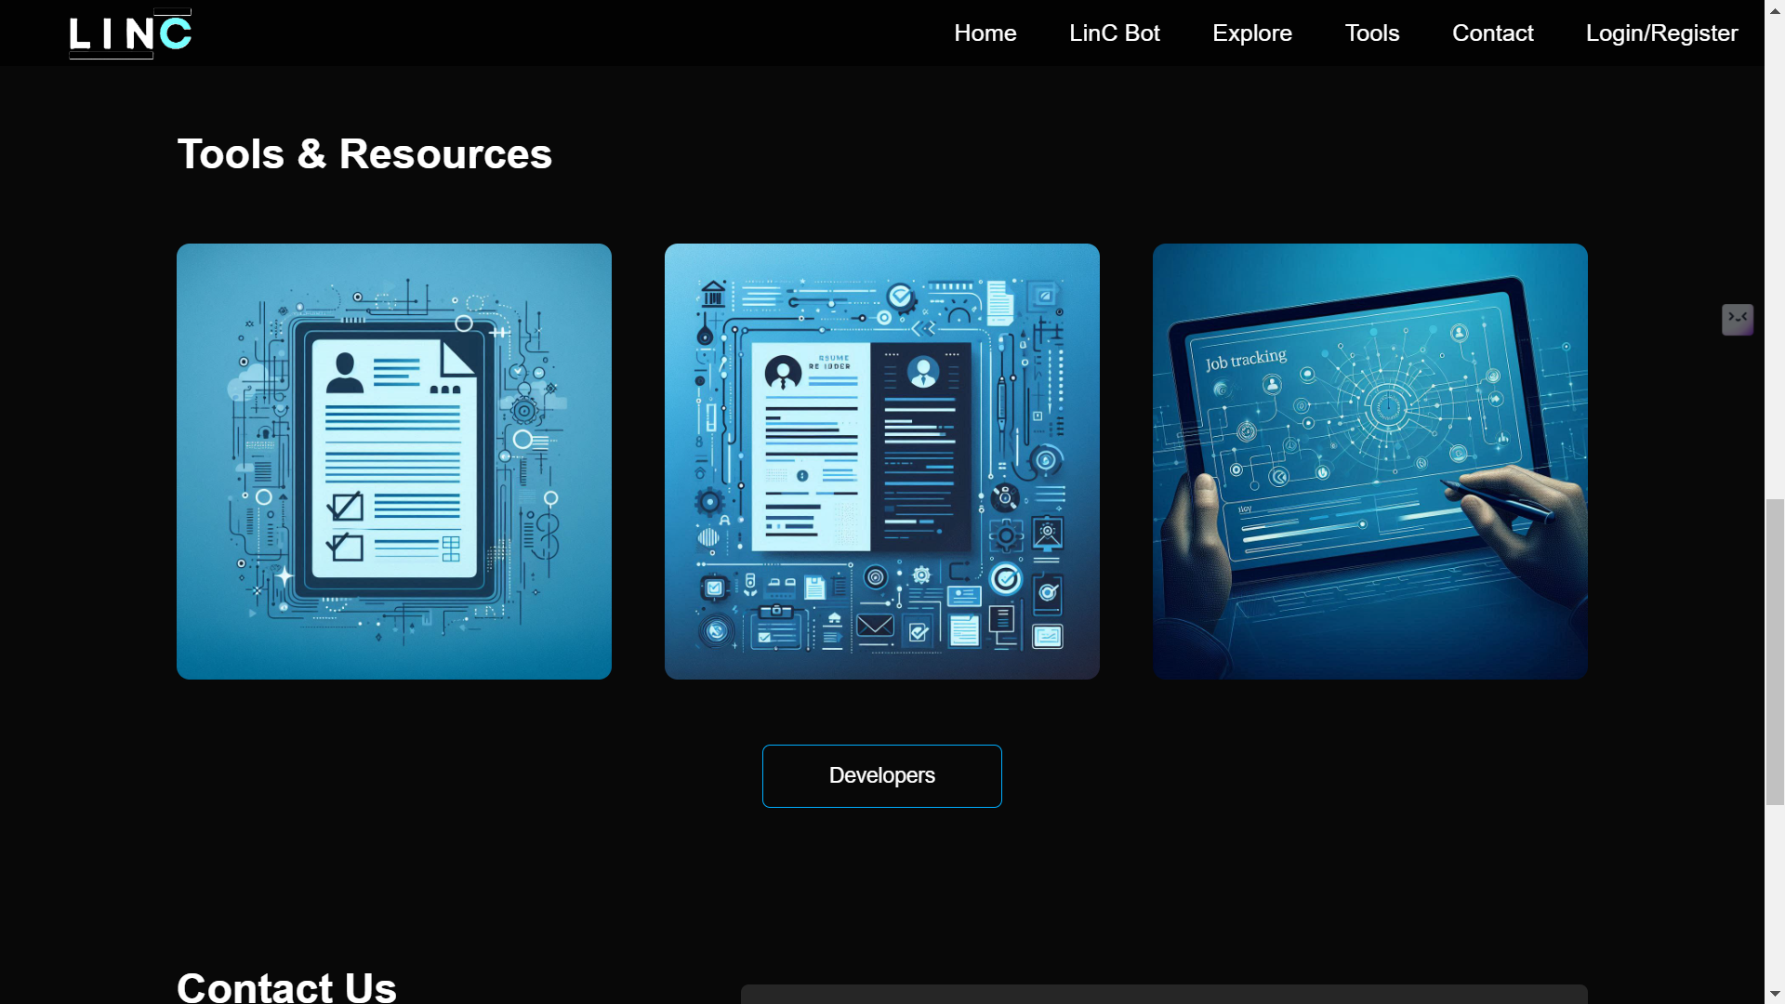

Slide 12
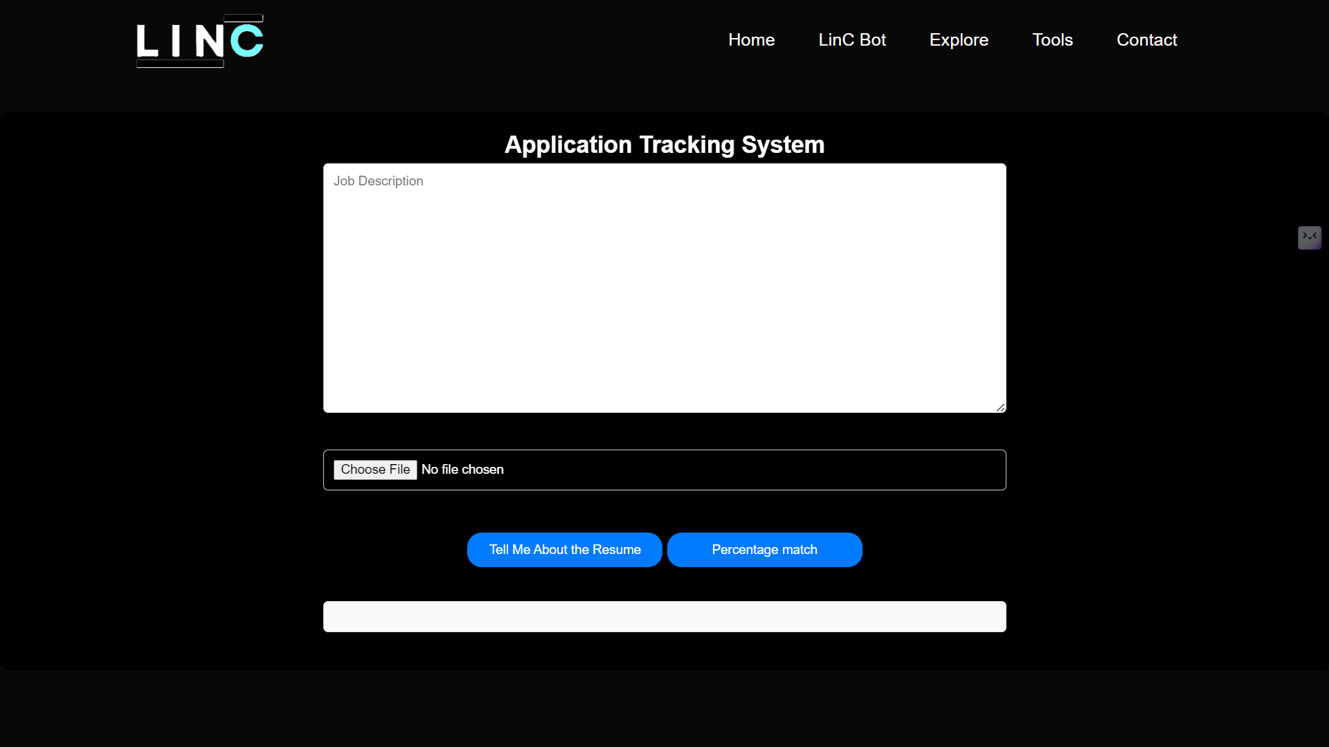

Slide 13
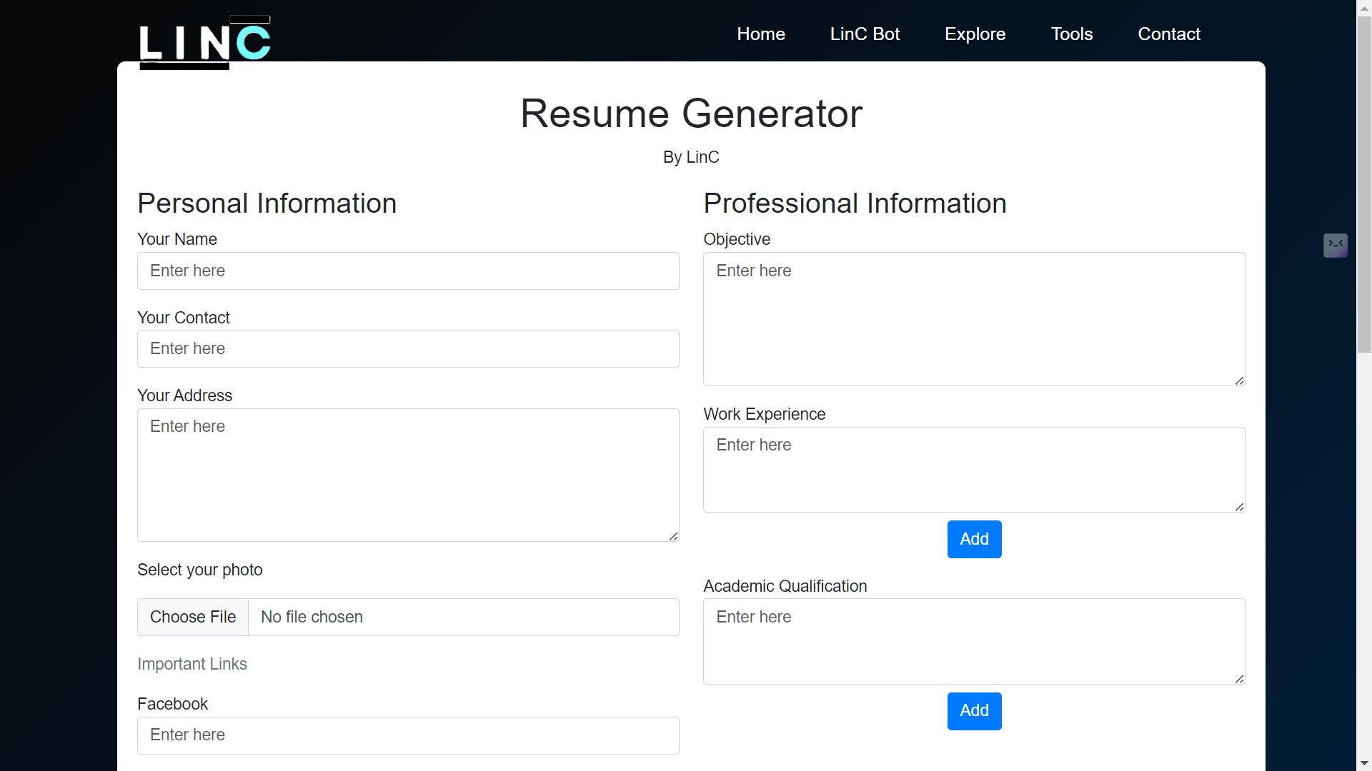

Slide 14
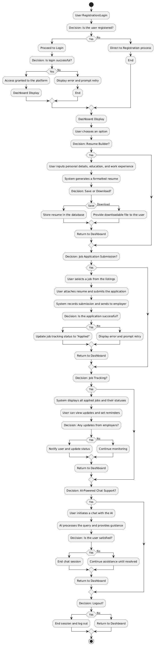

Slide 15
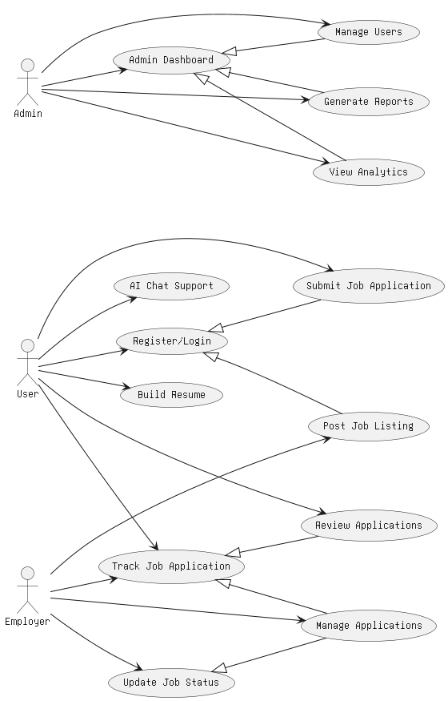

Slide 16
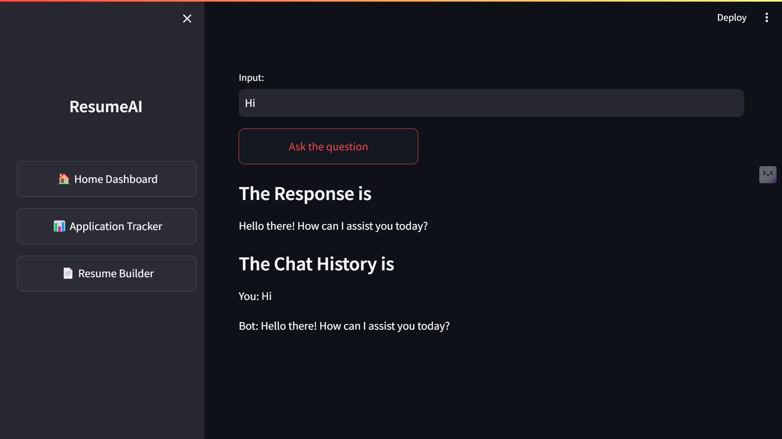

Slide 17
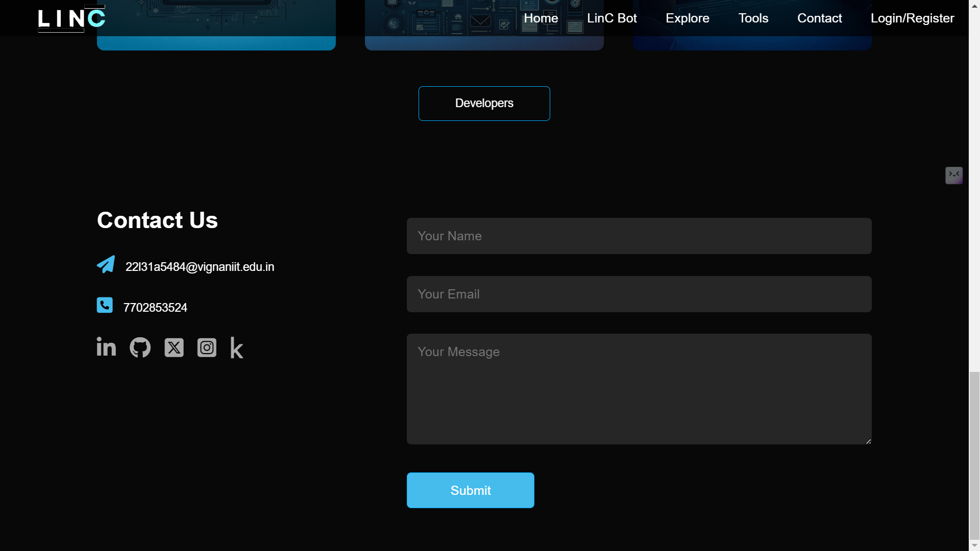

Slide 19
THANK YOU

